Slide 1
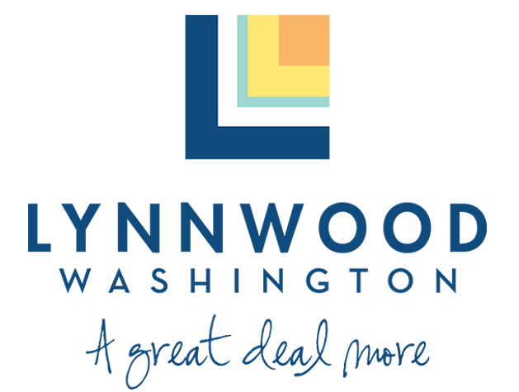
Underground Ordinance Planning Commission March 23, 2023
David Kleitsch, Development & Business Services Director
Karl Almgren, AICP, Community Planning Manager
Yeyi Chen, Assistant Planner

Slide 2
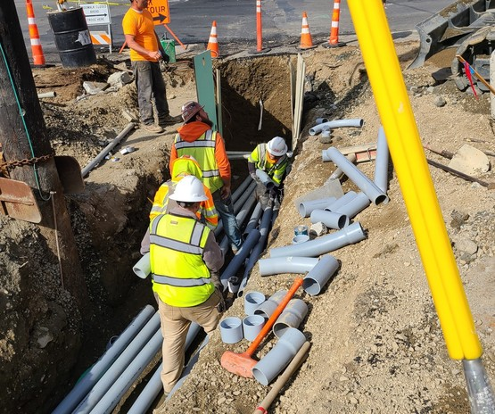
Purpose
Implement Existing Policies
Community Character Goal 8: Protect and enhance Lynnwood’s aesthetic and visual character through landscaping, tree preservation, public art and code administration and enforcement.
Policy CC-8.3 Where feasible, work with utility companies to underground overhead utility lines upon redevelopment.
Development Projects in City Center and Regional Growth Center
Existing Regulation for City Center (2006)

Slide 4
Before Undergrounding

Slide 5
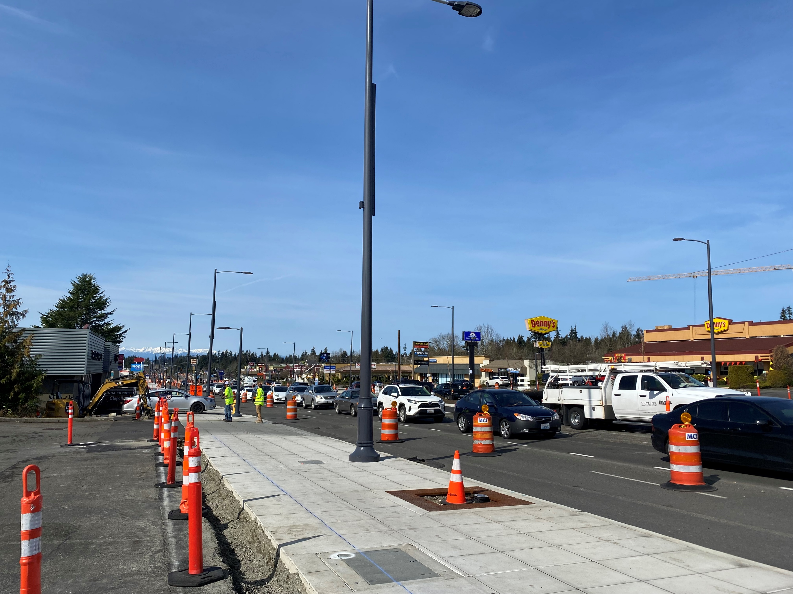
After Undergrounding

Slide 6
Ordinance Components
Costs:
City Initiated Projects:
City Shall Be Responsible for the Cost and Expense
Combined City-Initiated/Sponsored and Property Owner-Initiated:
Responsible for their Respective Cost and Expense as Agreed to
Delay of Installation:
Public Works Director May Authorize Delay
Cost Effective And Efficiently In Conjunction With Other Projects
Part Of City Financing (Local Improvement District)
Exemptions:
Existing High Capacity Transmission Lines Along I-5 and the Interurban Trail Providing Critical Regional Service are Exempt.

Slide 7
Next Steps
Refine Ordinance Based on Commission Comments
Planning Commission Public Hearing on April 27, 2023
City Council Review for Adoption in Q2 2023

